Slide 1
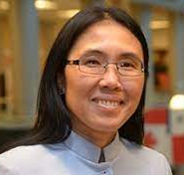
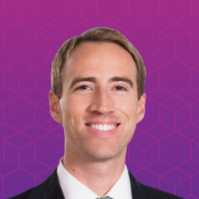
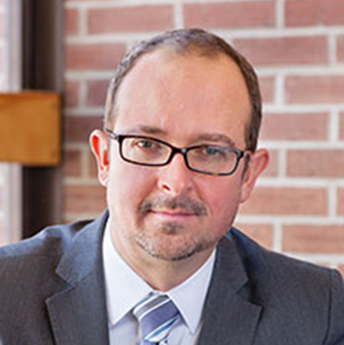
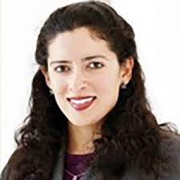
BLOCKCHAIN & NFTS: Latest Developments from Cryptocurrencies to Music, Games, and Fashion Industry
Panel 2
Music, Games and Taxation
Prof. Xuan-Thao Nguyen
Gerald L. Bepko Chair Director, Center for IP Law & Innovation
IU Robert H. McKinney School of Law
Cole Davis
Founder
Switchchord
Prof. Jeffrey Maine
Assoc. Dean for Research Maine Law Foundation Professor of Law
Pervin Taleyarkhan
Legal Counsel, Whirlpool Corp.
Dir., IP Clinic , IU McKinney School of Law
Moderator

Slide 2

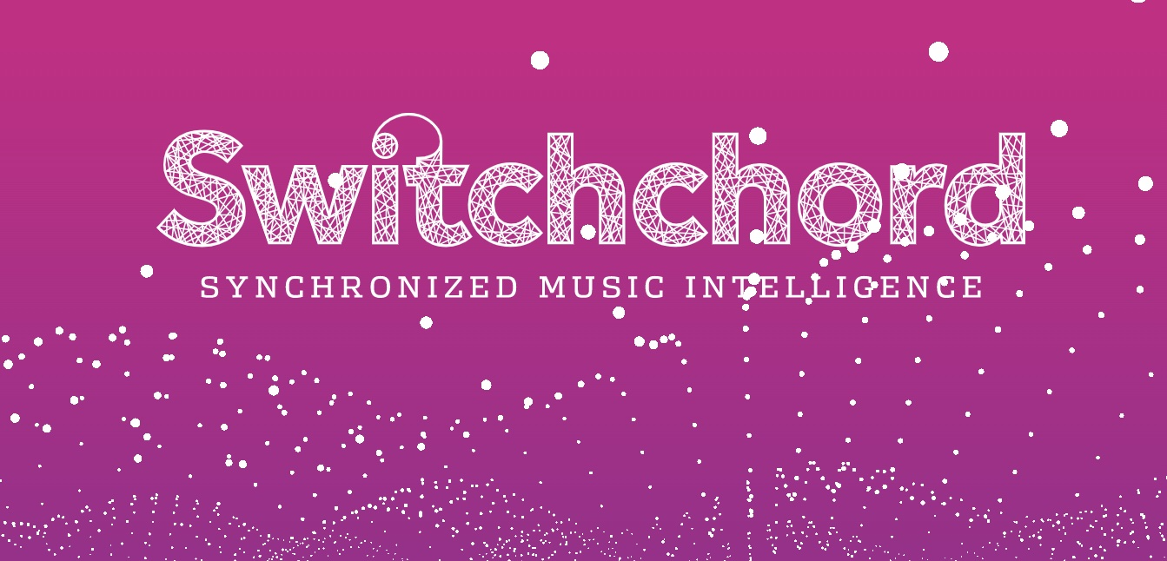
Cole Davis
Founder
Switchchord
Copyright licensing and management platform providing back office functionality for the entertainment industry. More details soon.
Notes:
All P2P
With bitcoin, we can think of the cells of the spreadsheet being who owns what bitcoins

Slide 3
Blockchain
Magic excel spreadsheet
Notes:
All P2P
With bitcoin, we can think of the cells of the spreadsheet being who owns what bitcoins

Slide 4
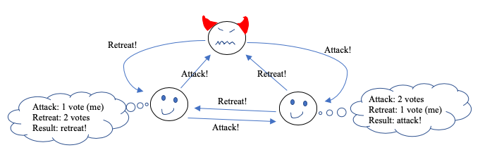
Blockchain
How do we update the magic spreadsheet?
Notes:
We don’t want a split network – all nodes have to agree to update their “state” with the same updates when we take a step forward in time; all spreadsheets need to look the same

Slide 5
Blockchain
Distributed ”consensus” is hard
“public” blockchains = lottery to propose an update
“permissioned” blockchains = elect leaders for each round / vote on what updates to make before making them
DON’T SPLIT THE NETWORK!
Notes:
We don’t want a split network – all nodes have to agree to update their “state” with the same updates when we take a step forward in time; all spreadsheets need to look the same

Slide 6
Blockchain
What can we put in the cells of the magic excel spreadsheet?
Bitcoin = who owns what bitcoins
Ethereum = computer code
“Smart contracts” = computer code in a cell of a magic excel spreadsheet that all nodes maintain
Updating the spreadsheet with a new “block” of “transactions” = running the computer code on every node
Notes:
We don’t want a split network – all nodes have to agree to update their “state” with the same updates when we take a step forward in time; all spreadsheets need to look the same

Slide 7
“Smart Contracts”
Smaller spreadsheets within the bigger magic spreadsheet
Notes:
All P2P
With bitcoin, we can think of the cells of the spreadsheet being who owns what bitcoins

Slide 8
Non-Fungible Tokens (NFTs)
Entries in a smaller spreadsheet (usually “ERC-721” “smart contract”) within the bigger spreadsheet
NFT identifiers
Public keys that “own” the NFT Identifier
Notes:
All P2P
With bitcoin, we can think of the cells of the spreadsheet being who owns what bitcoins

Slide 9
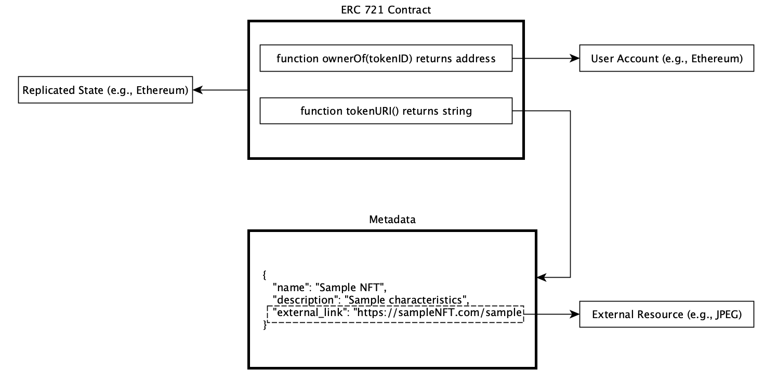
NFTs Under the Hood
Notes:
All P2P
With bitcoin, we can think of the cells of the spreadsheet being who owns what bitcoins

Slide 10
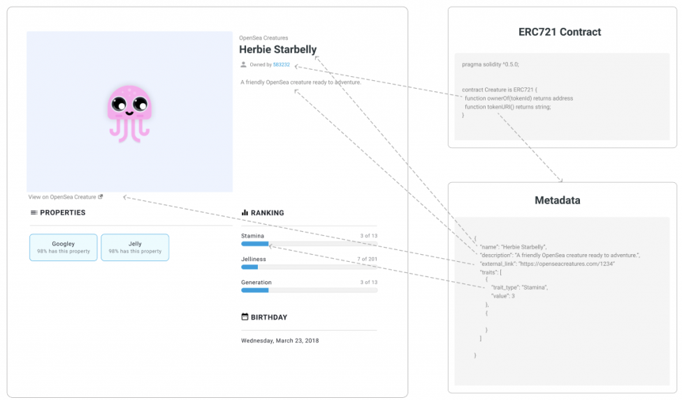
NFT
Notes:
All P2P
With bitcoin, we can think of the cells of the spreadsheet being who owns what bitcoins

Slide 11
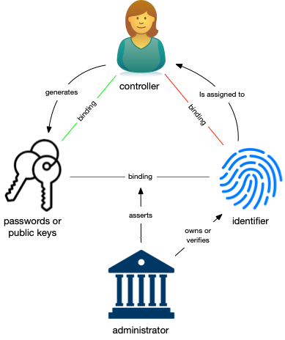
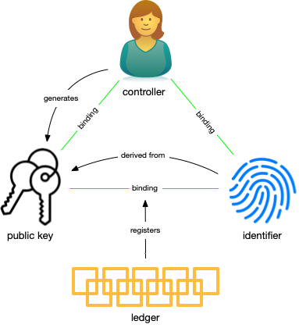
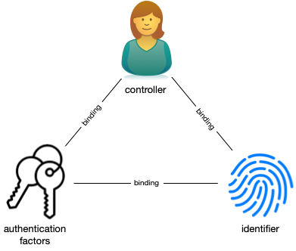
Decentralized Identifiers
Administrative
Algorithmic
(blockchain bindings)

Slide 12
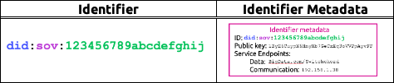
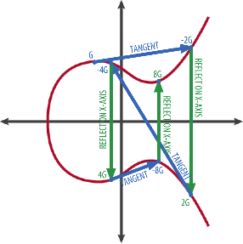
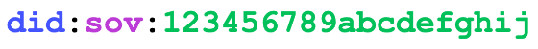
Decentralized Identifiers
Private key
KxKbiMZgYbXugn1gJVnGwnEuagB9qmj7n188dtLg7o2yoWBkA58h
Identifier metadata
ID:
Public key:
Service Endpoints:
Data:
Communication:
Payment:
1ByE6CuypX6HnyNb7GeCxEq3oVVPpAyvFF
BigData.com/Switchchord
192.158.1.38
[public key / API info]
Public key
+
Metadata
1ByE6CuypX6HnyNb7GeCxEq3oVVPpAyvFF

Slide 13

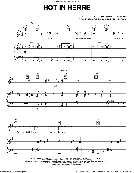
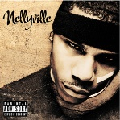
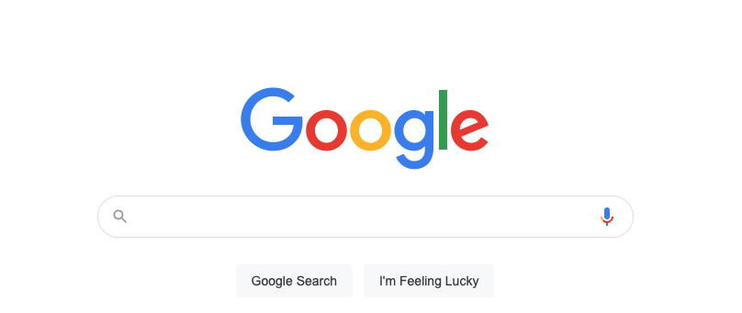





Switchchord Synch Licensing Marketplace
Licensor identifiers control song and recording identifiers
Licensor
identifiers
Song
identifier
Recording
identifier
Licensee
identifier
Aggregated data model
Project/use
Term
Media
MFN
Territory
Fee
Standard
Synch License
(Sony)
X X
Standard
Synch License
(Warner)
X X
Standard
Synch License
(Universal)
X X
Standard
Synch License
(Kobalt)
X X
Standard
Synch License
(Spirit)
X X
Hybrid
synch
licenses

Slide 14
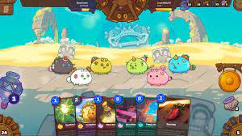
Blockchain Games Shifting IP and Corporate Paradigm?
Professor Xuan-Thao Nguyen
Gerald L. Bepko Chair in Law,
Director, Center for Intellectual Property & Innovation
Indiana University McKinney School of Law

Slide 15
Entrepreneurship & Blockchain Tokens
Democratize access to funding
Democratize access to investing opportunities
Building community of early adopters and developers
Facilitate open-source projects

Slide 16
Non-Fungible Tokens (NFTs) Craze
Beeple’s legendary “Every days — The First 5000 Days” ($69m)
Paris Hilton and Blake Kathyn’s “Iconic Crypto Queen” ($1.1m)
Singer Grimes’ “War Nymph” collection ($6m+)
Boxer Logan Paul’ set of Pokemon-inspired collectibles (over $3.5m sold in a single day)
Disclosure’s NFT song ($110k)

Slide 17
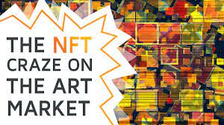
Non-Fungible Tokens (NFTs)

Slide 18
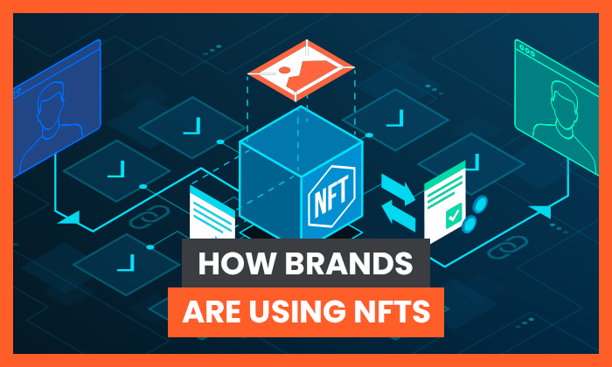
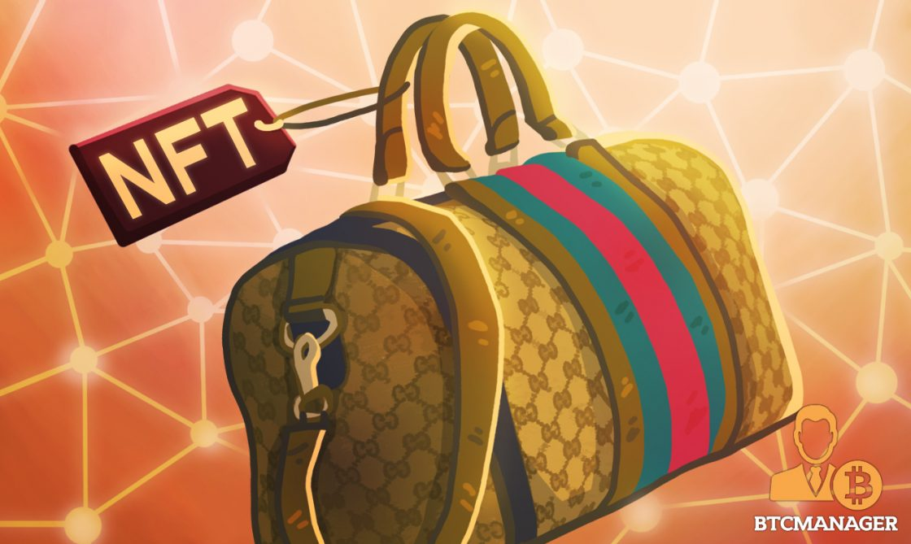
NFT & Brands
Every sale and re-sale produces a digital certificate of ownership. No counterfeit or duplicate of the same asset can be made. Ownership is indisputable.

Slide 19

NFT?
Digital assets on a blockchain
Non-fungible
Unique
ERC-721

Slide 20
NFT & Patents?
IBM owns 38,541 Patents
How to monetize patents? Licensing
“tracks ownership of and transactions involving the patent and/or patent licenses on the blockchain represented as NFTs”
Each NFT as a patent license to the holder of the NFT
To create a more liquid patent license market

Slide 21
NFT & Patents?
Bayh-Dole Act of 1982
Universities as owners of patent portfolios
University Tech Transfers & NFTs
https://techtransfercentral.com/2021/06/09/ipwe-creates-advisory-committee-to-focus-on-university-tech-transfer-and-nfts/

Slide 22
NFT & Patents?
Patent Disclosures and Fundraising
https://news.berkeley.edu/2021/05/27/uc-berkeley-will-auction-nfts-of-nobel-prize-winning-inventions-to-fund-research/

Slide 23
IP & USER RIGHTS???

Slide 24
IP PARADIGM
The Doctrine of Repair and Reconstruction in Patent Law:
permissible repair of a patented article
The owner of the property repairs to preserve its utility and operability guarantees
Impermissible reconstruction of a patented article, which is patent infringement.
Aro Mfg. Co. v. Convertible Top Replacement Co.

Slide 25
IP PARADIGM
IP HOLDERS (CORPORATIONS)
CUSTOMERS AS USERS PAY AND CONSUME IP-BASED PRODUCTS AND SERVICES

Slide 26
Can the Blockchain Technology be Used in Ways to Shift the IP Paradigm?

Slide 27
Blockchain Games?
Users of the IP-based Products be the true owners of what they create (the property)
Users earn $$ for the production of the IP-based Products (P2E Business Model)
Users of the IP-based Products have governance votes in Community Treasury (fees generated from transactions that Users participated)

Slide 28
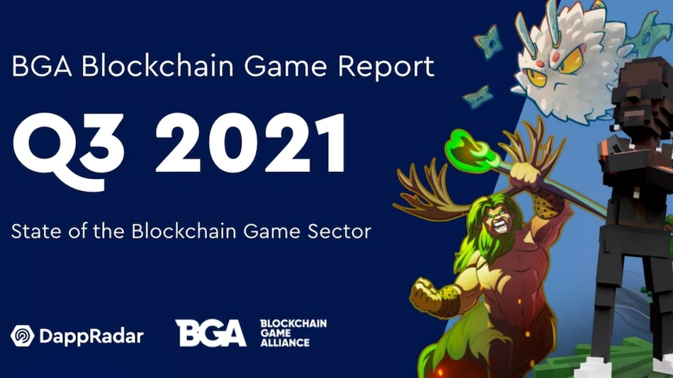
Play to Earn (P2E) Blockchain Games

Slide 29
Users as True Owners of the Property
Blockchain records ownership, transfers, sales, etc.
Gamers own the NFTs (in-game characters)
Participate in real markets for transfers, sales, etc.

Slide 30
Users with Governance Votes
Fees from transactions that users participate go to a Community Treasury
Early users stake in the games (rewards to long-time keeping the governance tokens): vote on what to do with the Community Treasury

Slide 31
Crypto Taxation
Jeffrey A. Maine
University of Maine School of Law

Slide 32
Tax Guidance on Taxation of Crypto U.S. Ranked 14th
Convertible Virtual Currency (e.g., Bitcoin)
IRS Notice 2014-21
Rev. Rul. 2019-24
IRS FAQs (answers to 43 FAQs), irs.gov
Chief Counsel Advice 202114020
IRS Legal Memo 202124008
Nonfungible Tokens (NFTs)
Nothing

Slide 33
Taxation of Convertible Virtual Currencies
Mining
Staking
Hard Forks (with and without Airdrops)
Dispositions
Sale of Crypto for Cash
Exchange of Crypto for Another Crypto
Exchange of Crypto to Purchase Goods/Services
Gifts/Devises of Crypto
Lost Possession/Theft
Charitable Contributions
Decentralized Crypto Loans

Slide 34
Taxation of NFTs
Creation
Purchase
Sale
Capital or Noncapital Asset?
Creator? Dealer? Investor?
Application Capital Gains Rate?
Work of art?
Future income streams?
Charitable Contribution
Loss/Worthlessness

Slide 35
Summary
Tax-Free Crypto Asset Activities
Creating NFTs
Buying crypto/NFTs (with cash…not crypto)
Acquiring crypto/NFTs by “gift”
Holding crypto/NFTs
Hard Fork of crypto
Transferring crypto between your own wallets
Gifting crypto/NFTs or donating crypto/NFTs to charity
Taxable Crypto Asset Activities
Compensation for services with crypto (income)
Crypto rewards (mining rewards, staking rewards) (income)
Crypto airdrops (income)
Dispositions of crypto/NFTs (gain or loss)
Theft/Worthlessness (loss)

